Slide 1
Apache Spark code optimisations

Slide 2
Watch this for tips on optimizing performance
https://www.youtube.com/watch?v=NXp3oJHNM7E
Be careful the examples in the slides are in python.
The next two slides are from here. I have converted them into scala.

Slide 3
Avoid GroupByKey if possible
(patrick, $24), (matei, $30), (patrick, $1), (aaron, $23), (aaron, $2), (reynold, $10), (aaron, $10)…..
RDD
Copies all data over the network
spendPerUser = rdd .groupByKey() .map(pair => (pair._1, pair._2.reduce(_+_)) .collect()
spendPerUser = rdd .reduceByKey(_+_) .collect()
Using reduceByKey is much better
will do local aggregation
Reduces locally before shuffling

Slide 4
Large number of “empty” tasks due to selective filter
rdd = sc.textFile(“s3n://bucket/2013-data”)
.map(_.split(“\t”))
.filter(_(0) == “2013-10-17”)
.filter(_(1) == “19:00”)
rdd.map(parts => (parts(2), parts(3))).reduceBy…
Maybe data spread across 1000 partitions but only 2 contain the data we want.
The reduceBy will still run on the partitions which contain no data after the filtering.
Detecting Many short-lived (< 20ms) tasks
Fixing
Use `coalesce` or `repartition` operator to shrink RDD number of partitions after filtering:
rdd.coalesce(30).map(parts => (parts(2), parts(3))).reduceBy …

Slide 5
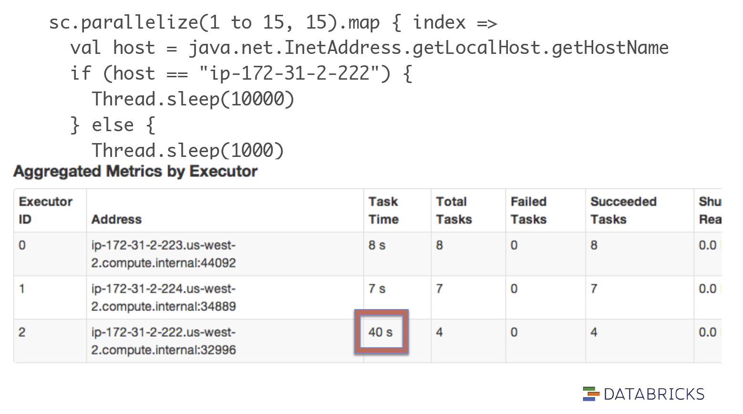
Stragglers due to slow nodes

Slide 6
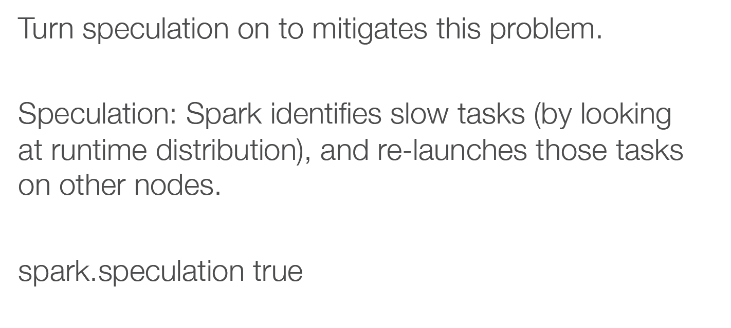
Stragglers due to slow nodes

Slide 7
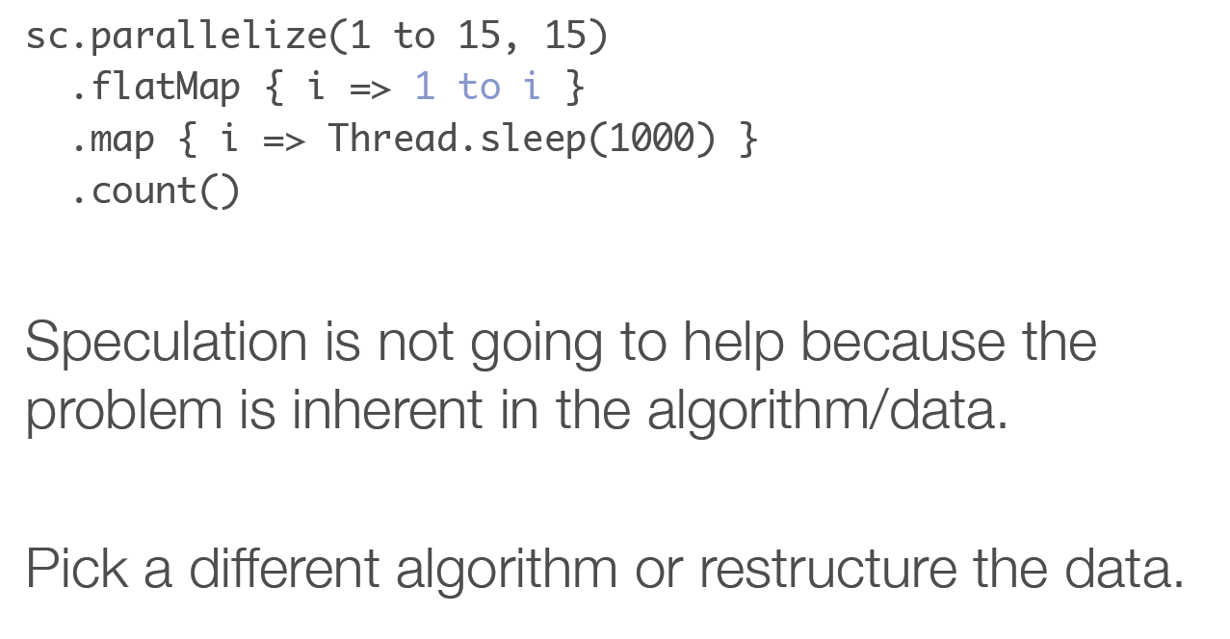
Stragglers due to data skew

Slide 8
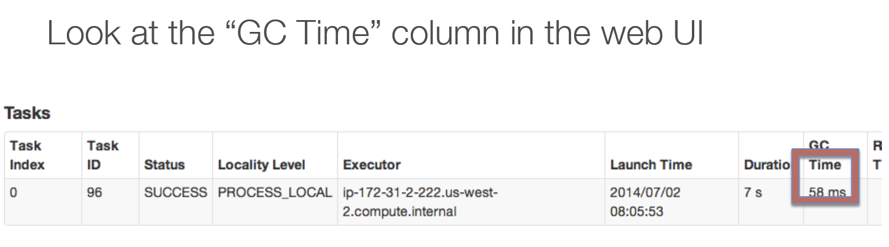
Garbage Collection

Slide 9
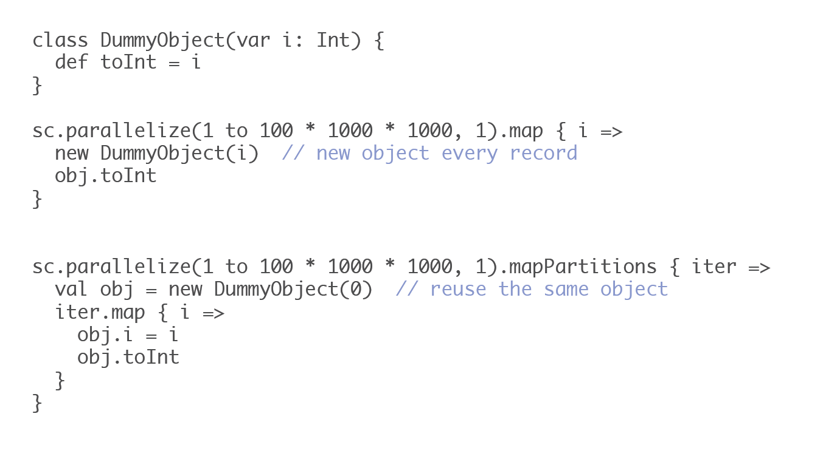
Reduce Garbage Collection Time

Slide 10
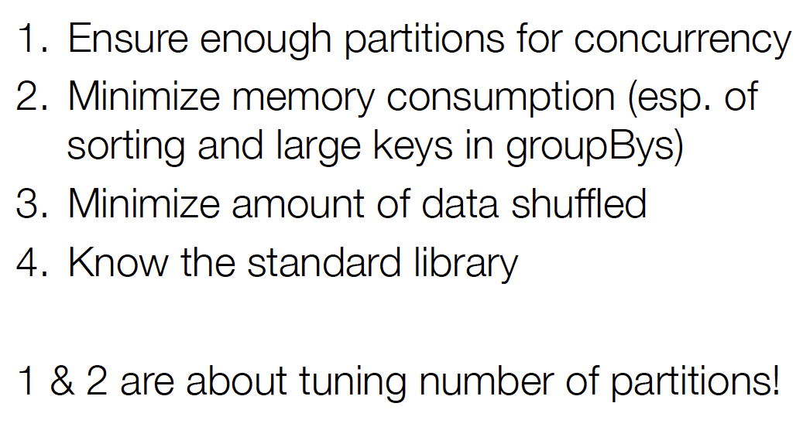
Common issue checklist

Slide 11
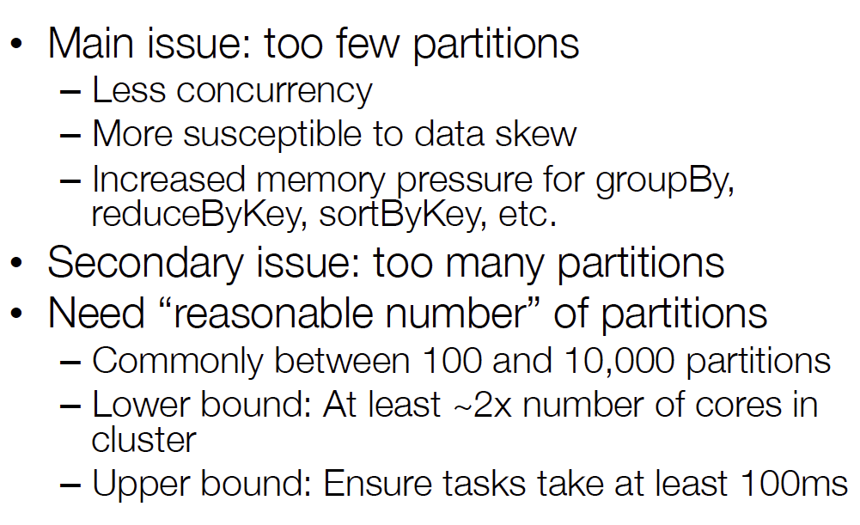
Importance of Partition Tuning
val x = sc.parallelize(List(1,2,3,4,5,6), 5)
Number of partitions

Slide 12
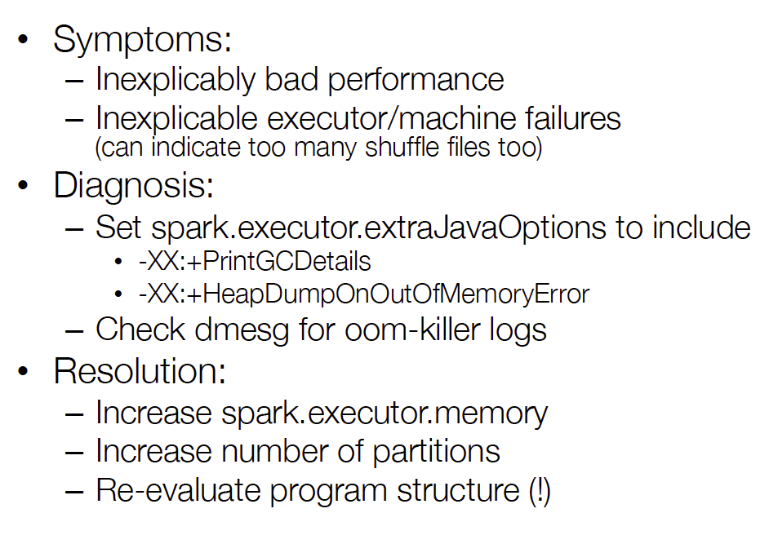
Memory Problems

Slide 13
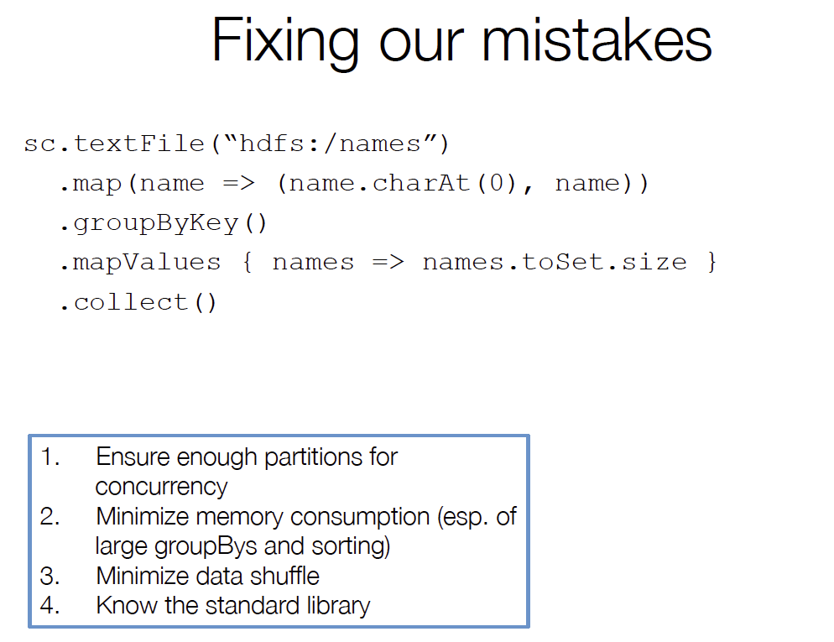

Slide 14
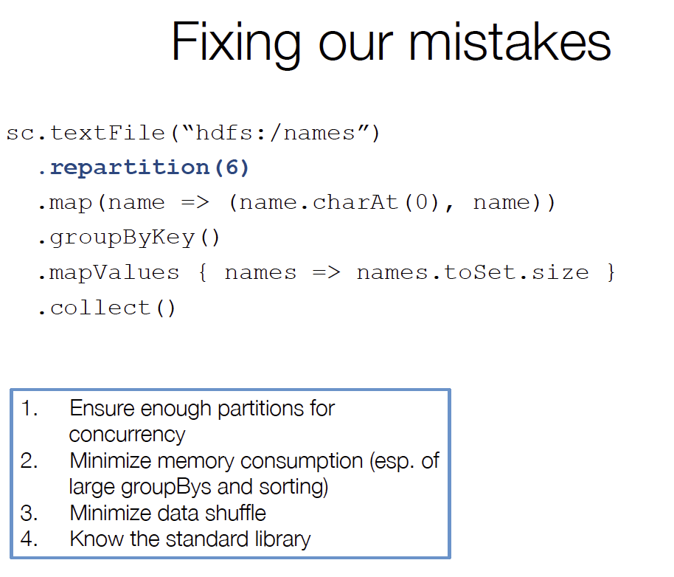

Slide 15
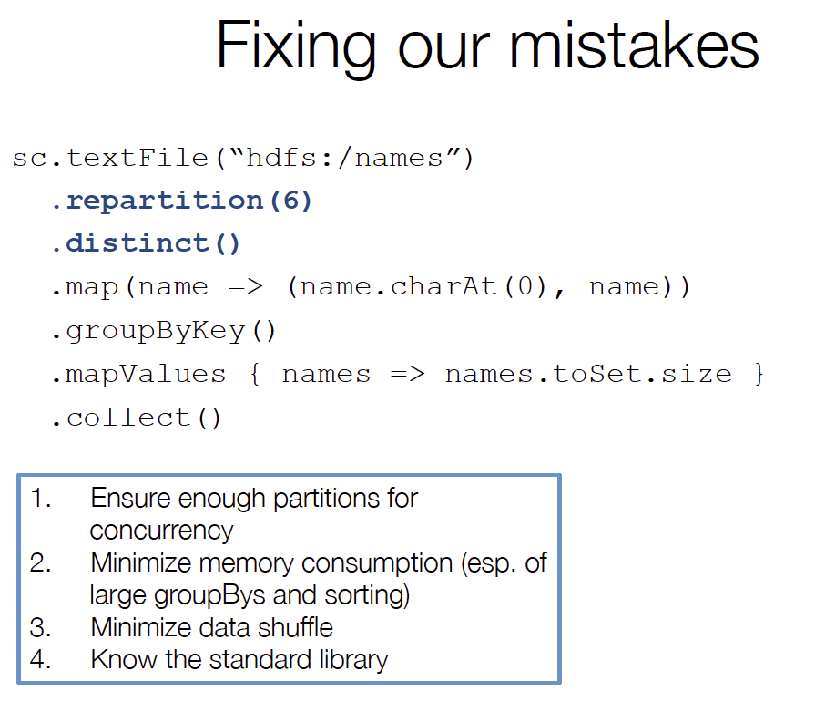

Slide 16
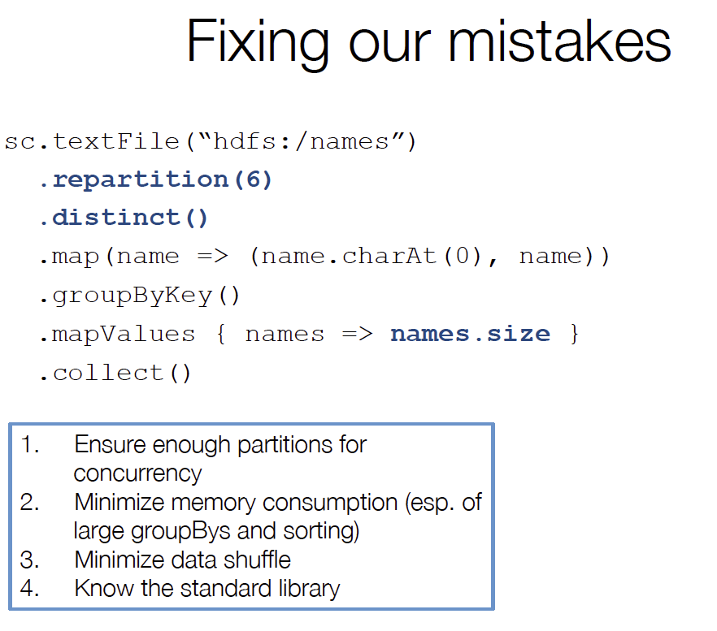

Slide 17
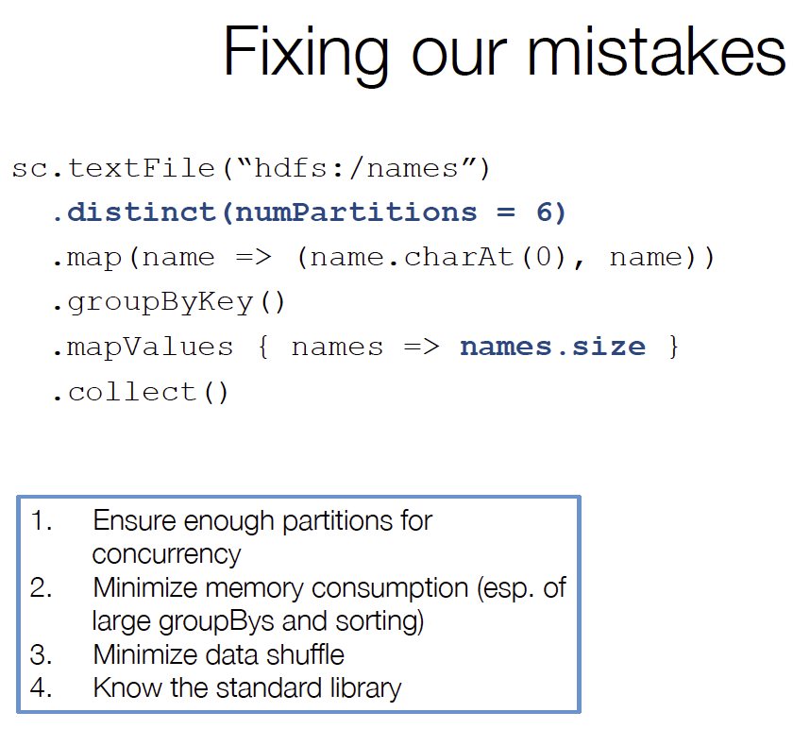

Slide 18
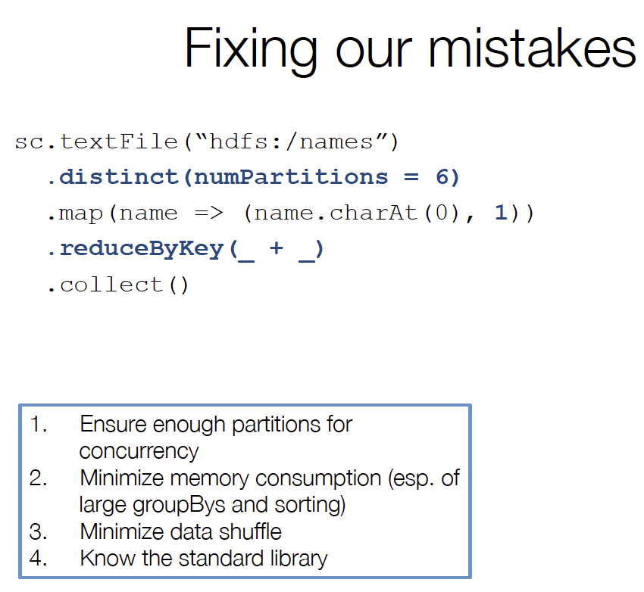

Slide 19
